Slide 1
UNDERSTANDING AUTISM: A SPECIAL EDUCATOR’S PERSPECTIVE
Clare K. Kariisa
21/09/2022

Slide 2
Autism Spectrum
An umbrella term - used to describe a neurodevelopmental condition that leads to indicative behavioural challenges in :
socialisation and communication,
as well as by the presence of restricted, repetitive and stereotyped behaviours
Varied and diverse - It includes different levels and severity for everyone
Unique characteristics - Every individual with Autism presents differently from the next individual with autism

Slide 4
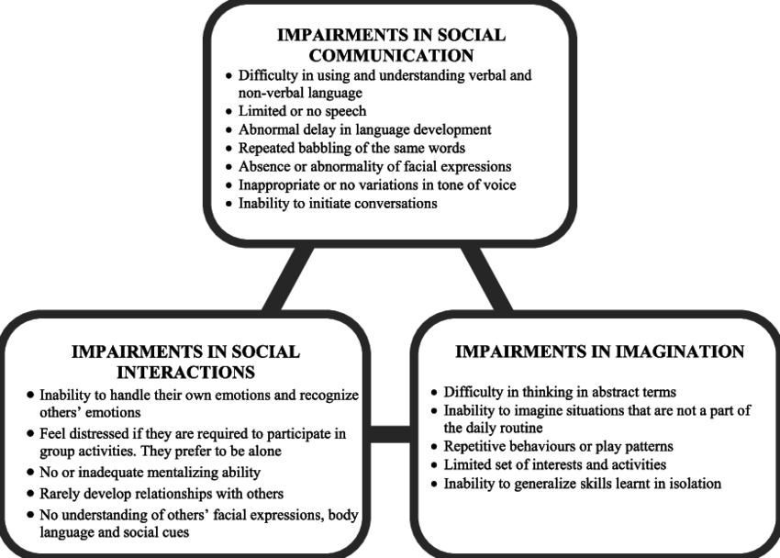

Slide 5
Sensory Processing Challenges
Touch
Sound
Light
Texture
Smell
Taste
Movement
Balance
Body positioning and Muscle Control

Slide 6
Sensory “Stimming”
Stimming – stereotypical and repetitive behaviours that help the individual to:
self-regulate;
relax; and
process information (stimulus) when in a stressful situation or environment (or even when alone)

Slide 8
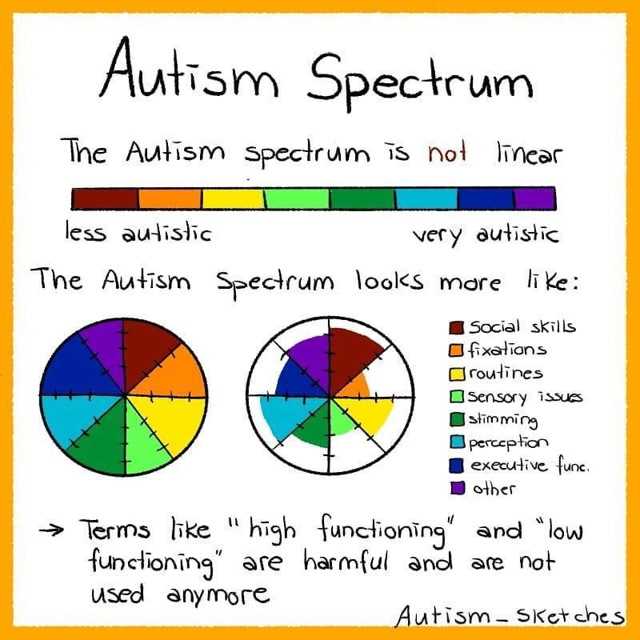

Slide 9
Diagnosis, Cause and Cure
Diagnosed mainly by observing behaviour not by medical tests (i.e. no blood test needed). A diagnosis may involve:
Behaviour evaluation
Testing basic skills
Cognitive tests
Hearing and Vision testing
Any of the following is able to assess/screen autism;
Clinical Psychologist
Child Psychologist
Neurologist
Neuro-peadiatrician
Other specialists e.g. speech and language therapist,occupational therapists, etc.
Causes are unknown - Combination of genetic predisposition and environmental factors (toxic chemicals; heavy metals, etc.)
*Much debate about link to vaccines
More common in boys than in girls (Ratio of 4:1)
No known cure – managed through various therapies and interventions

Slide 10
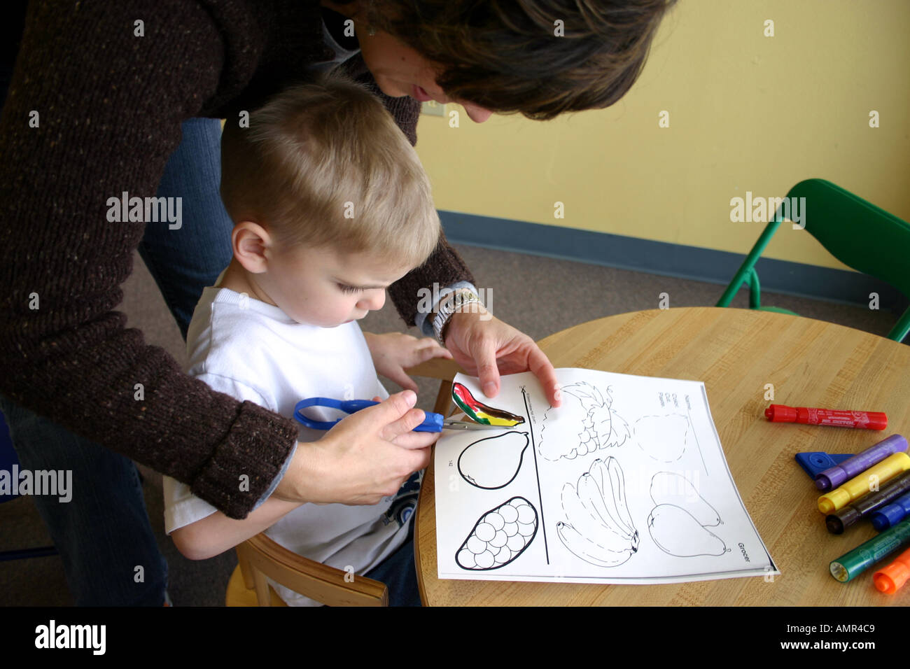
Interventions/Approaches for managing children with Autism
Speech and language therapy
Occupational therapy
Physiotherapy
Sensory integration therapy
Behavioural therapy
Play therapy
Educational interventions
Nutritional support & Supplementation

Slide 11
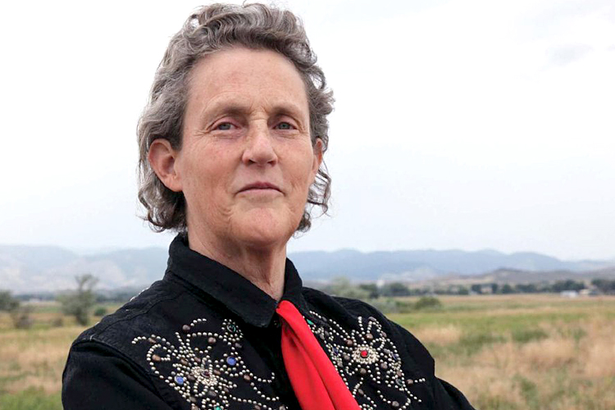
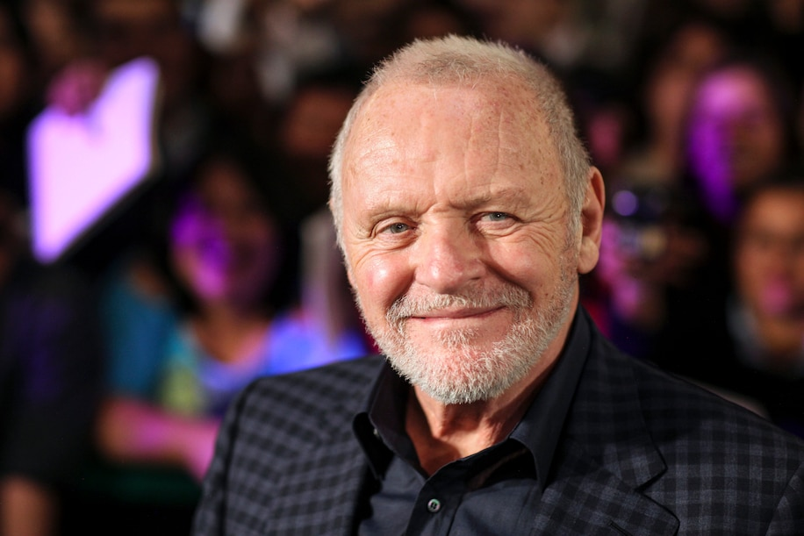
Familiar Faces … on the Spectrum

Slide 12
Familiar Faces … on the Spectrum

Slide 13
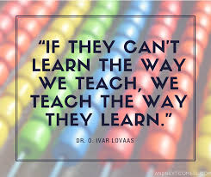
Autism in the Classroom – Special Ed Teacher Role
Gather info from parents, teachers, professionals and develop action plans
Work with general Ed teachers to develop Individual Education Plans (IEPs)
Develop appropriate educational intervention techniques to support students with learning difficulties
Manage students behaviour in the classroom and teach/model appropriate coping strategies
Conduct individual or small group activities with students, based on differentiated learning needs
Assist students stay on task within the classroom and also keep-up with assignments et al
Development of creative teaching/learning tools and methods suited to student needs
Etc.

Slide 14
“…Look for the ability not the disability ...”
(Anon)

Slide 15
Thank You

Slide 16
Questions

Slide 17
Resources
https://clarajamestutoring.co.uk/understanding-autism/
https://goodautismschool.com/autism-umbrella/
https://www.inha.ie/sensory-processing-disorder/
https://luxai.com/blog/all-about-stereotyped-behaviours-stimming-and-autism/
https://www.biography.com/business-figure/elon-musk
https://www.washingtonpost.com/outlook/2021/09/08/wentworth-miller-anthony-hopkins-autistic-celebrities/
https://www.independent.co.uk/arts-entertainment/tv/news/prison-break-wentworth-miller-autism-b1891486.html
https://www.theguardian.com/commentisfree/2019/apr/23/greta-thunberg-autism
https://360behavioralhealth.com/social-skills-training-help-children-teens-ya-with-autism/
https://www.a2spectrumtherapy.com/social-skills-peer-groups

